Slide 1


Rationalize the Consumption of Antibiotics

Slide 2
Student Names: Department
Mohamed Said Abdel Fattah CS
Ahmed Mohamed Ismail CS
Ali Ahmed Ali IS
Arafa Ahmed Salem IS
Rady Mohamed Rady CS
Alaa Abdullah Tawfik IS
Supervised By:
Dr.Eng. Samy ElMokadem Dr. Abdelrahman El-Akhdar
Eng. Ahmed Rashad
Eng. Rabab Mahmoud

Slide 3
Problem Statement:
There is a large number of antibiotics are being wrongly used daily.
Each antibiotic can be used to treat more than one type of bacteria.
The antibiotics required to treat a patient vary These doses vary according to the patient's age, gender, health condition and other factors.
It is necessary to have a system followed in the consumption of antibiotics that aims to rationalize the consumption of antibiotics in their places of distribution, whether hospitals, clinics or pharmacies.

Slide 4
Project Objectives:
The project aims to build a system that helps rationalize the consumption of antibiotics. The best way to rationalize consumption is to monitor the number of patients, the types of diseases they have, and the doses required for the treatment process.
Objectives:
Insert/update Patient Records
Detecting if an antibiotic is being consumed inappropriately
Setting appropriate dosage instructions for each patient, according to the case, during the patient registration process
Monitoring and extracting patients' statistics at the hospital
Monitoring and extracting statistics of antibiotic consumption in the hospital

Slide 5
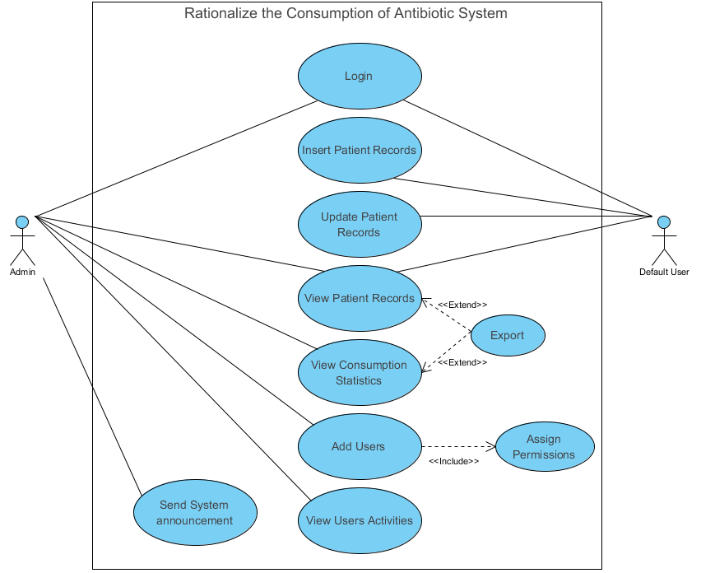
Usecase

Slide 6
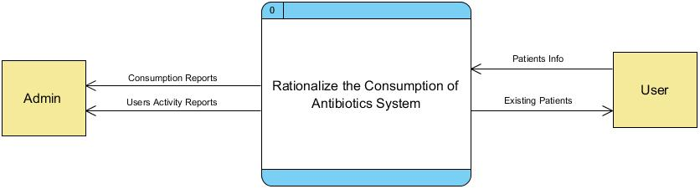
DFD Context
The base level of DFD on RCA Project shows the main input/output data on general bases, The user is responsible for inserting patients’ data into the system, Whereas the admin can monitor these data and see reports

Slide 7
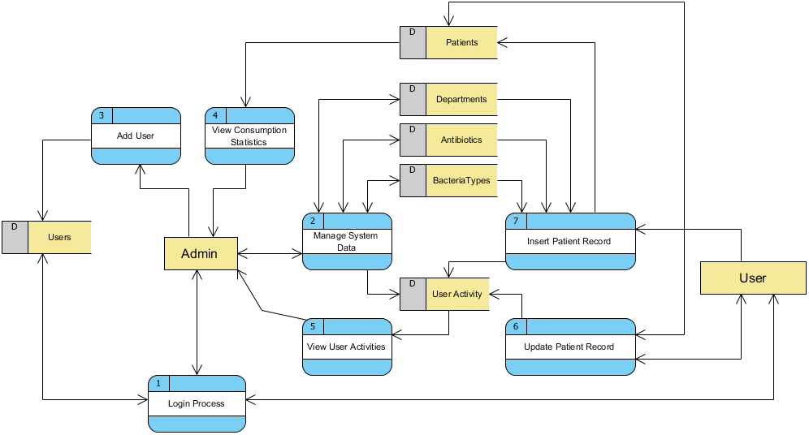
DFD Level 1

Slide 8
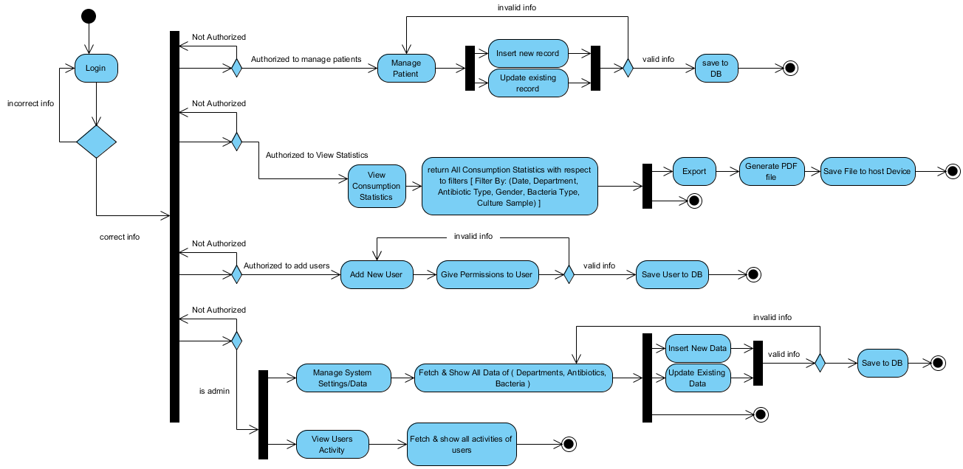
Activity

Slide 9
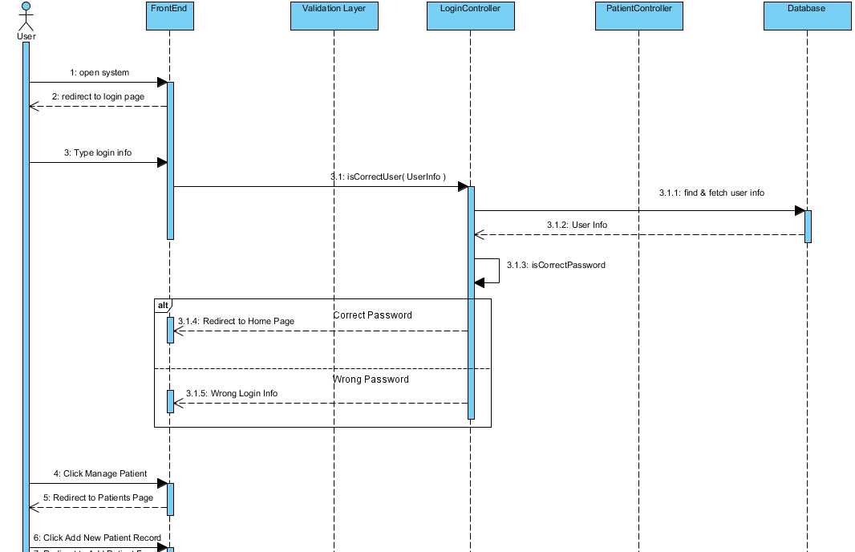
Insert Patient Sequence

Slide 10
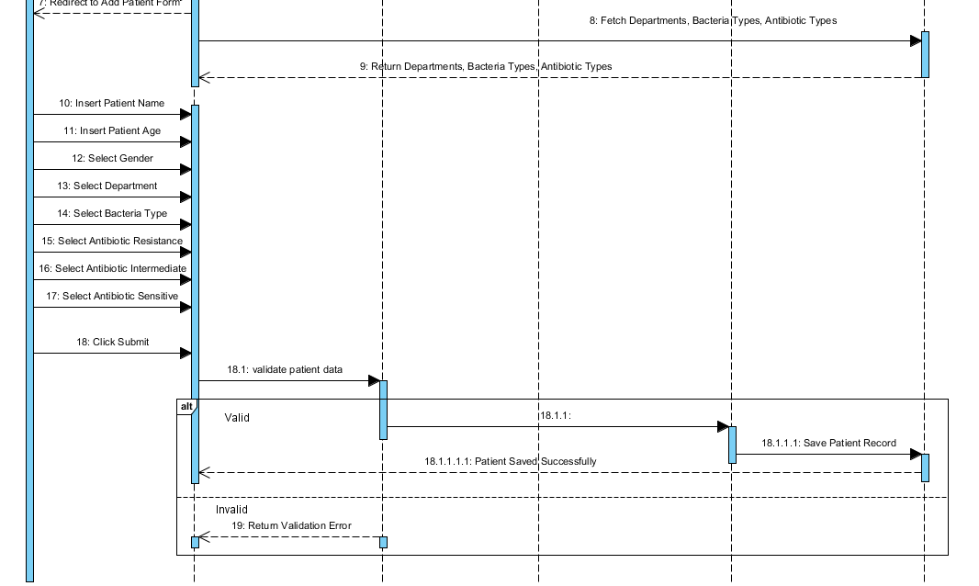
Insert Patient Sequence - Cont

Slide 11
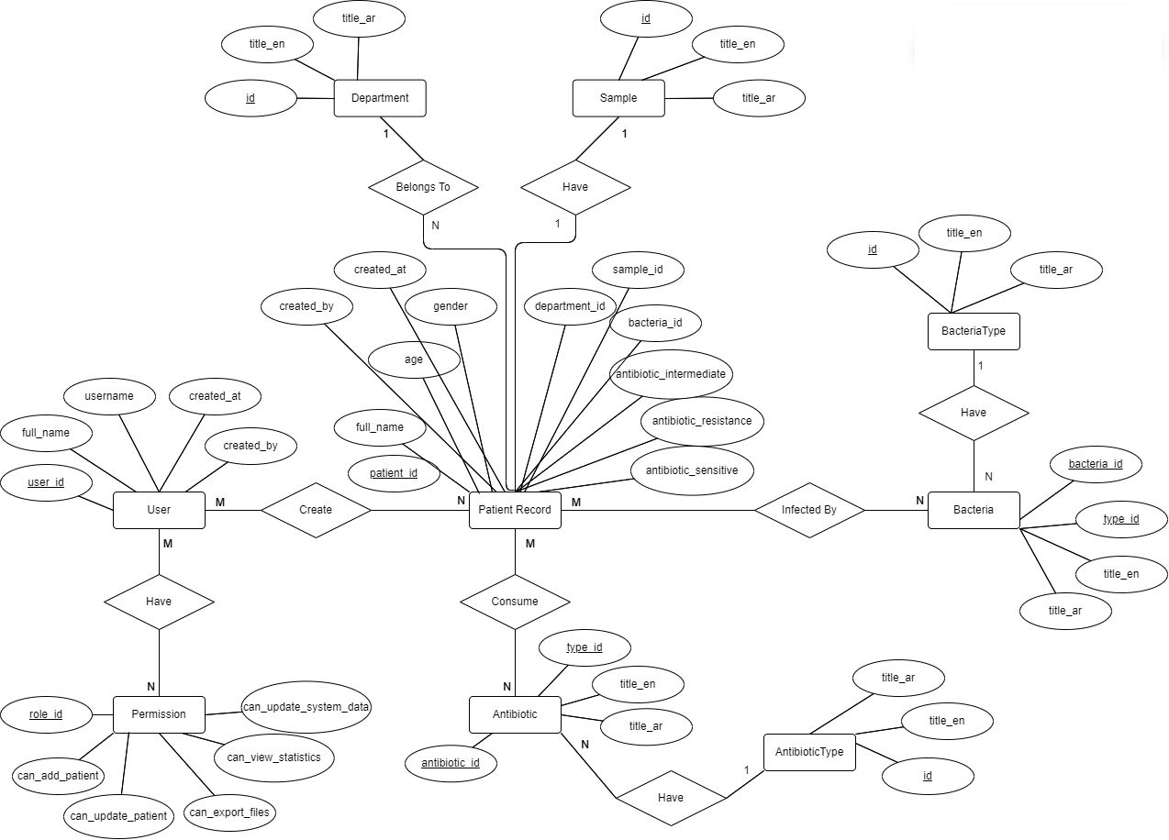
ERD

Slide 12
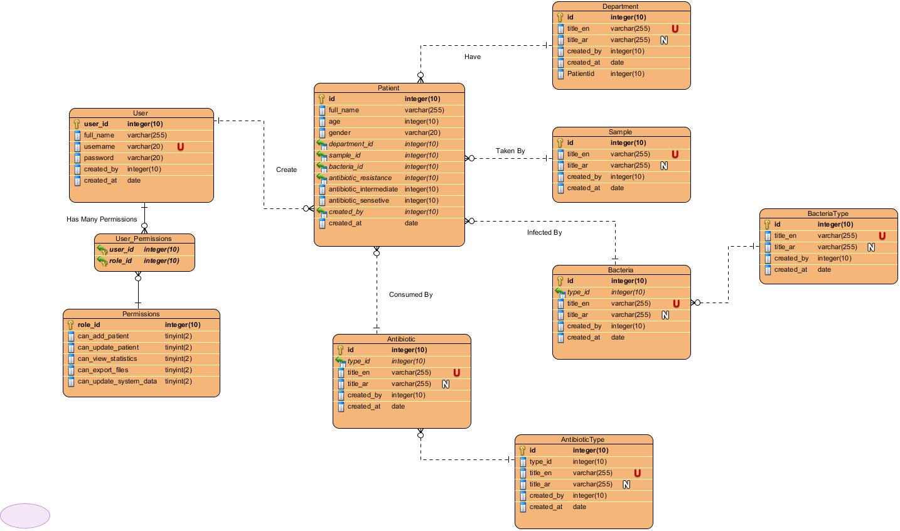
Entity Relationship Diagram(ERD)

Slide 13
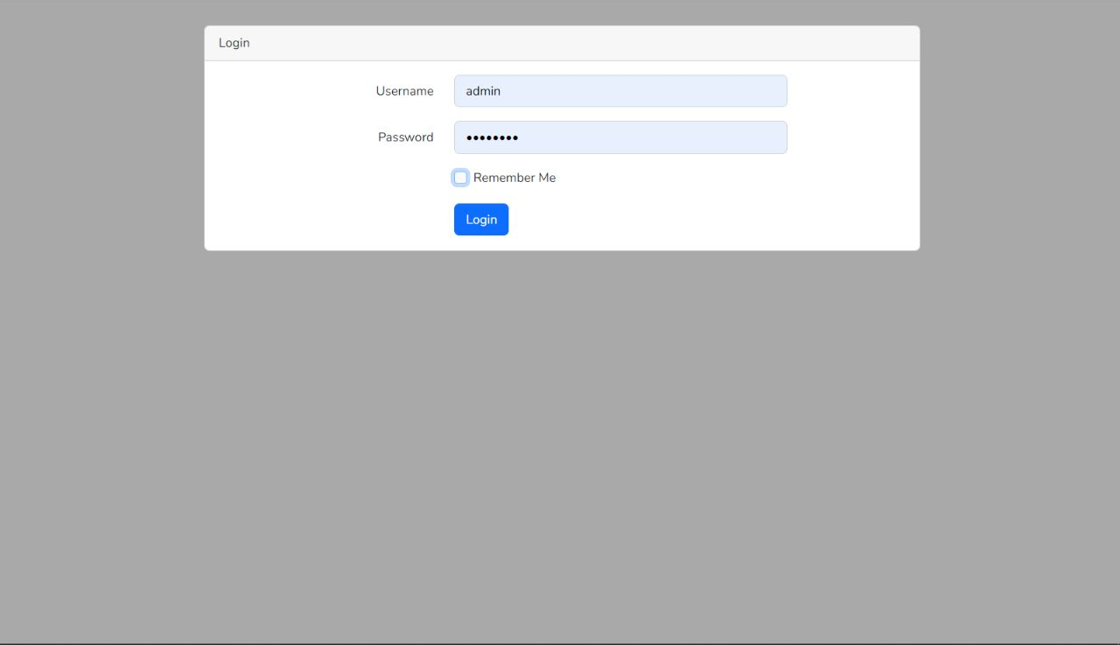
APP Design

Slide 14
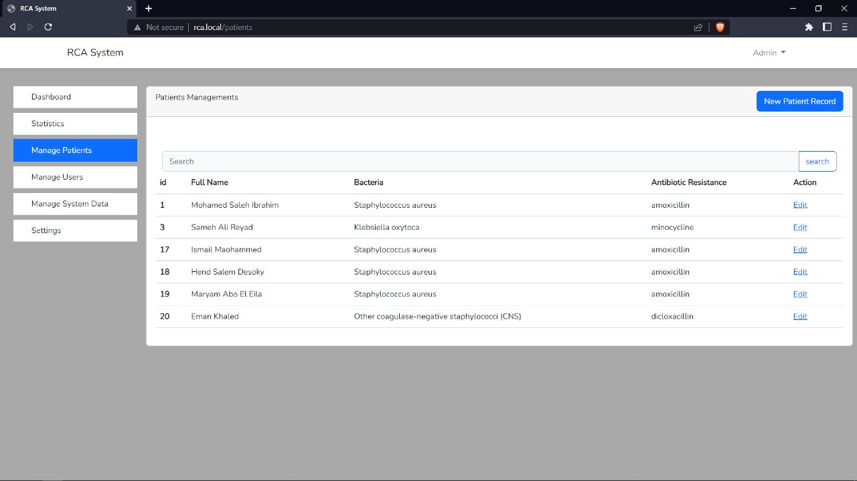

Slide 15
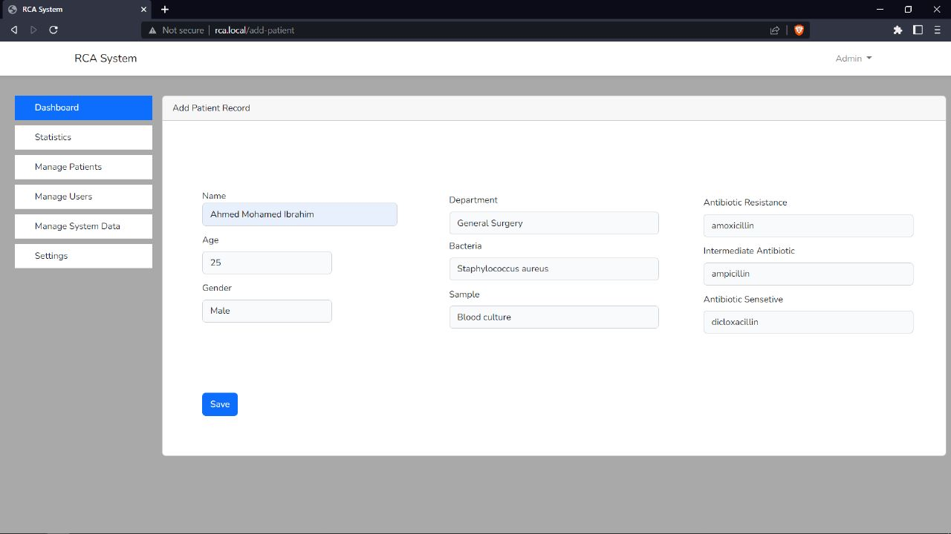

Slide 16
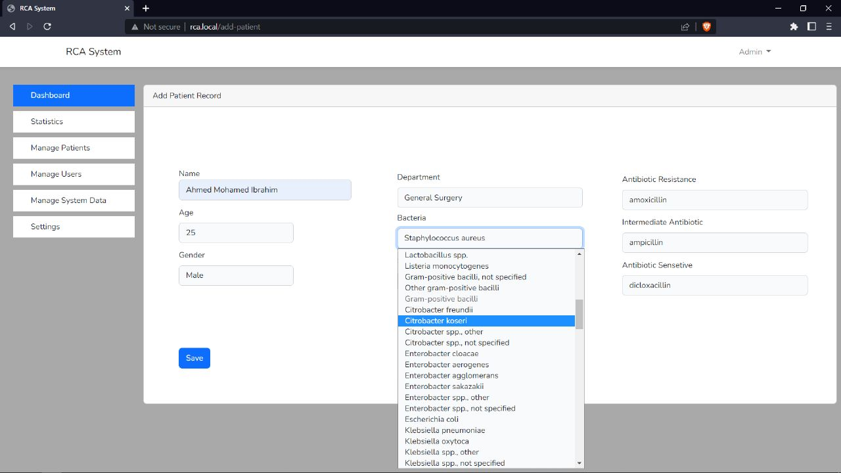

Slide 17
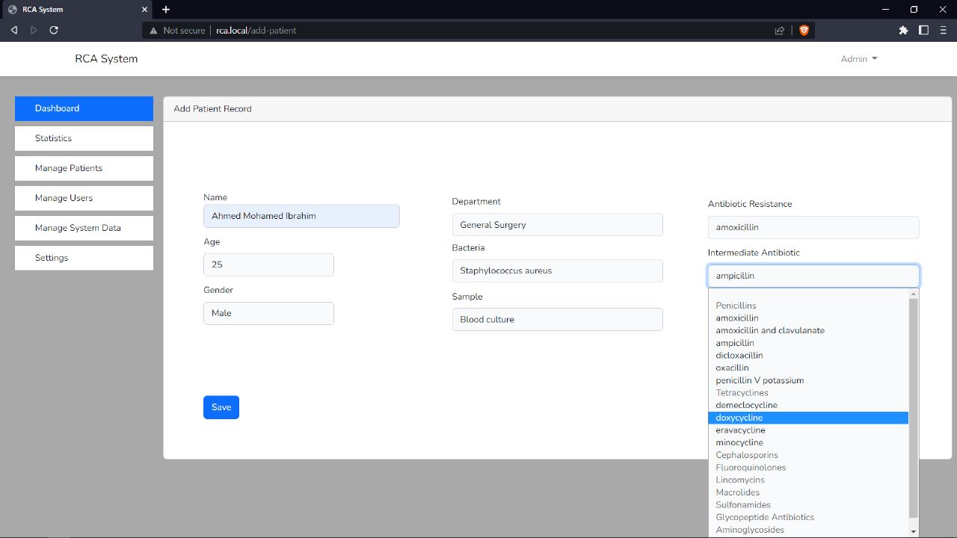

Slide 18
Tools
Front-end :
html5 , css3, JavaScript
jQuery
bootstrap
flutter
Back-end :
Laravel - Php
SQL
REST API
Version Control
git

Slide 19
System Conclusion
Admin can create many users with different permissions
Users can Fill & Update patient’s forms
Admin or Authorized users can monitor consumption statistics
Admin or Authorized users can send system announcements
Admin can track users activities
Admin can insert/update system data ( Departments, Bacteria Types, Antibiotic Types )

Slide 20
Future Work
Work on Statistics page, where users can monitor consumption statistics filtered by ( Date, Departments, Antibiotic Type, Bacteria Type)
Work on Mobile Application version of the system
Work on system deployment

Slide 21
Any Question ?

